Slide 1

ELK Project

Slide 2

Day 1 Start

Slide 3
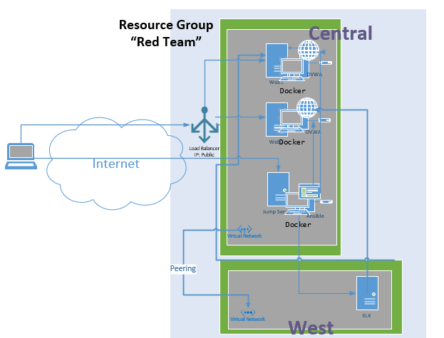
Original Project

Slide 4
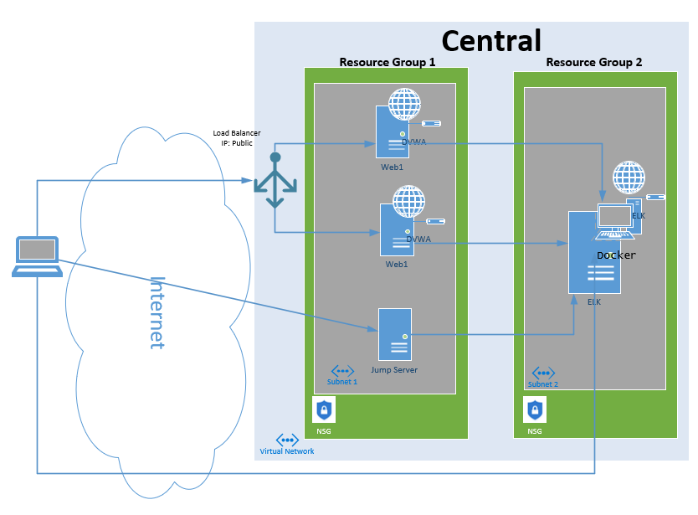
New Project

Slide 5

Check DVWA!
Before You Continue Building

Slide 6
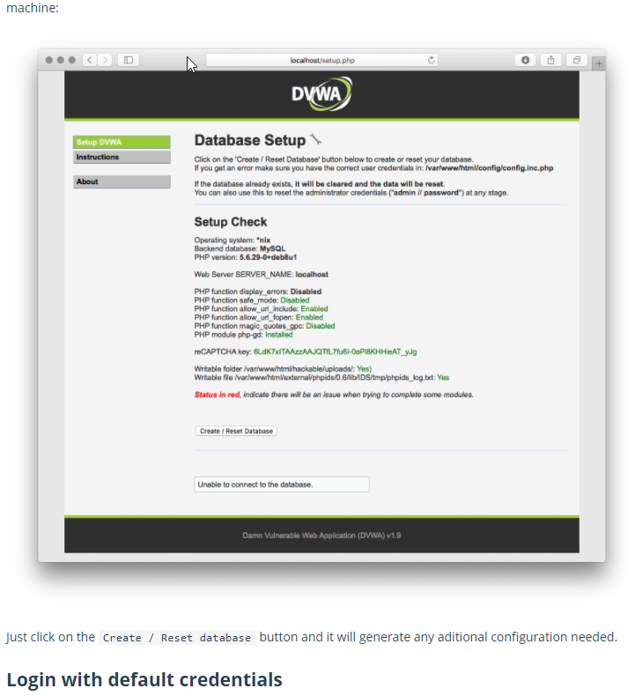
1. Browse to your newly built DVWA Solution 2. Log in using the instructions below and set the difficulty level
DVWA Check
https://hub.docker.com/r/vulnerables/web-dvwa

Slide 7

1. Create New Resource Group 2. Create New Subnet in Existing Virtual Network 3. Create New NSG w/ Deny(s) 4. Associate NSG to Subnet

Slide 8
Build a New Virtual Machine
Create a new VM
Within the new Resource Group
Name it Elk
Ubuntu
B Size – 2 CPU and 4 GB mem
With public IP

Slide 9

Connect and Configure
Allow SSH access from the Jumpbox to the new Elk Server
Connect to the Elk server from the jumpbox over SSH
Run the Elk Bash Script

Slide 10

Connect and Logon
Allow access to Elk over TCP 5601 from your home network
Browse to http://Your_IP:5601/app/kibana
Login to change the default password

Slide 11
Day 1 Complete

Slide 12
Day 2 Start

Slide 13
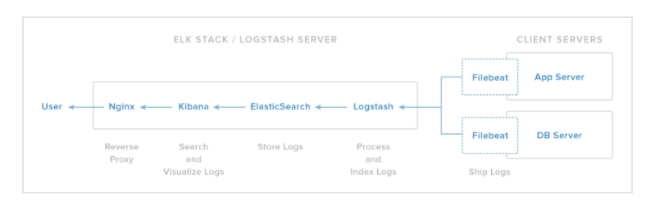
Push Logs from Web Servers to ELK

Slide 14
FileBeat Installation and Configuration
SSH into the Web Server through the Jumpbox
Execute the FileBeat Script
Update the Config File at /etc/filebeat/filebeat.yml
Scroll to line #1106 and replace the IP address with the IP address of your ELK machine.
Next, Update the Password.
output.elasticsearch:
hosts: ["10.1.0.4:9200"]
username: "elastic"
password: "changeme"
6. Scroll to line #1806 and replace the IP address with the IP address of your ELK machine.
setup.kibana:
host: "10.1.0.4:5601"
https://www.elastic.co/guide/en/beats/filebeat/6.8/filebeat-installation.html

Slide 15
Open Needed Ports
Open the needed port from Web Servers to ELK 9200
After, Start the Filebeat on the Web Server
filebeat modules enable system
filebeat setup
service filebeat start

Slide 16
Final Elk Project

Slide 17
Day 2 End

Slide 18
Day 3 Start

Slide 19
Home Work
Create a Github Repository - https://www.youtube.com/watch?v=XtCcoMd6U_4
Upload your scripts
Create a Network Diagram and Upload it
Submit
Word Document Including
Explain what you learned (two or more paragraphs)
Link to your Github Repository

Slide 20
Day 3 End

